Slide 1
Python Arcade
Instructor: Rob Garner
Based on tutorial at: https://arcade.academy/examples/platform_tutorial/index.html

Slide 2
Overview
Step 1 - Install and Open a Window
Step 2 - Add Sprites
Step 3 - Add User Control
Step 4 - Add Gravity
Step 5 - Add Scrolling
Step 6 - Add Coins And Sound
Step 7 - Display The Score
Step 8 - Use a Map Editor
Step 9 - Multiple Levels and Other Layers
Step 10 - Add Ladders, Properties, and a Moving Platform
Step 11 - Add Character Animations, and Better Keyboard Control

Slide 3
Step 1
Install and Open a Window

Slide 4
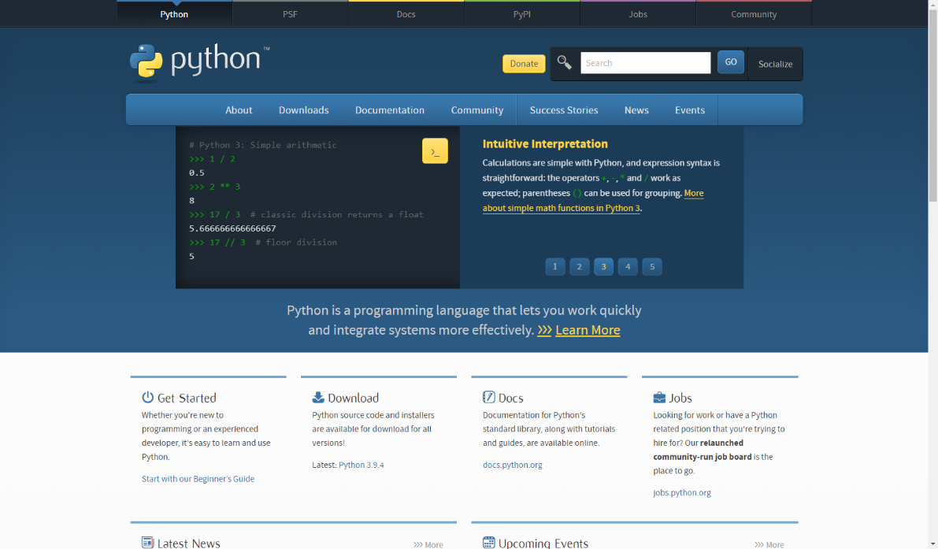
Installing Python
Workflow:
Go to www.python.org
Find the correct version for your machine (use Python 3.x).
Download
Install

Slide 5
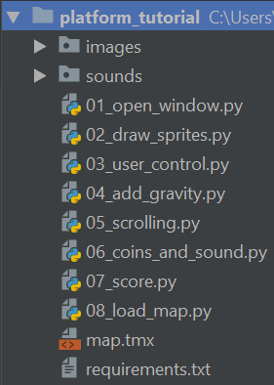
Download project bundls
Download and the zip file at: https://arcade.academy/_static/platform_tutorial.zip
Unzip it to a file on your drive.

Slide 6
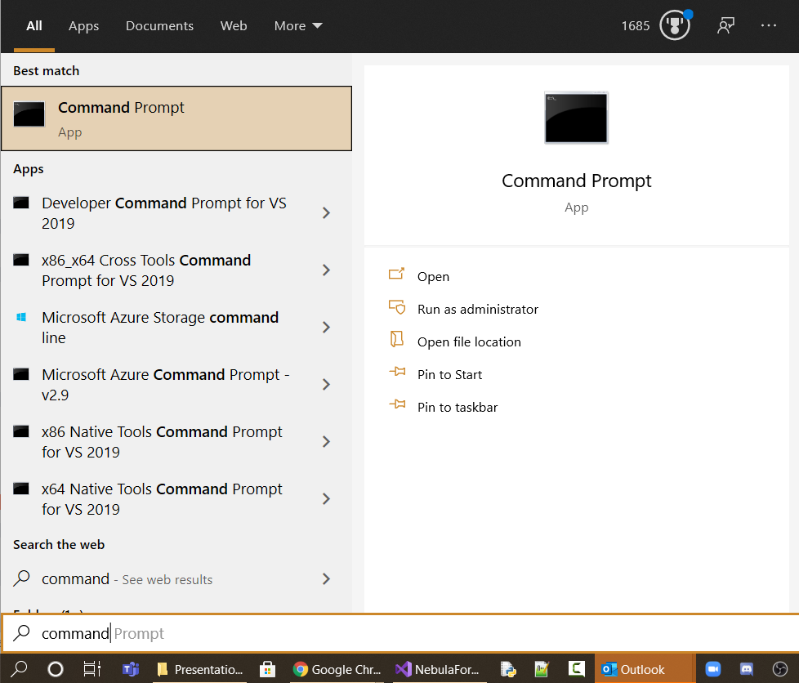
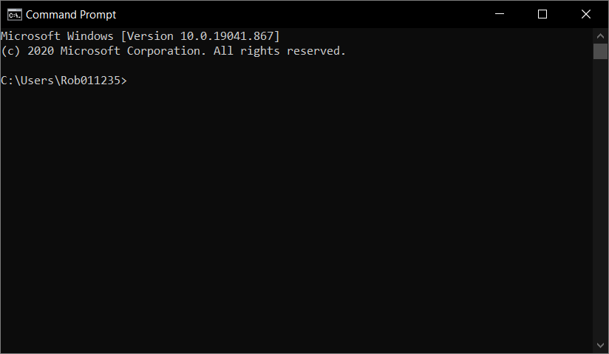
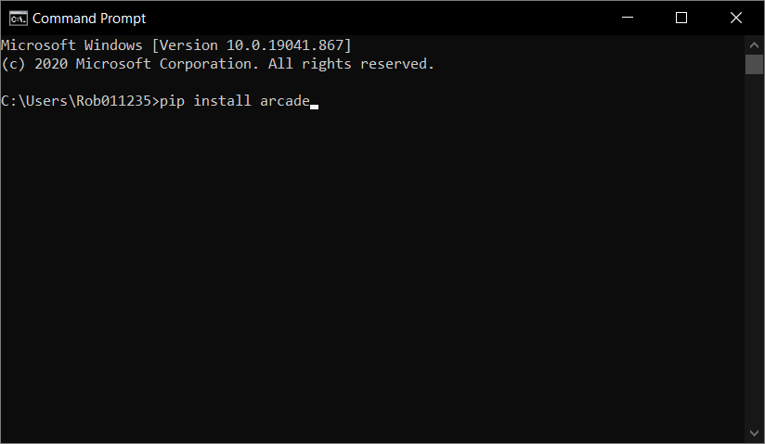
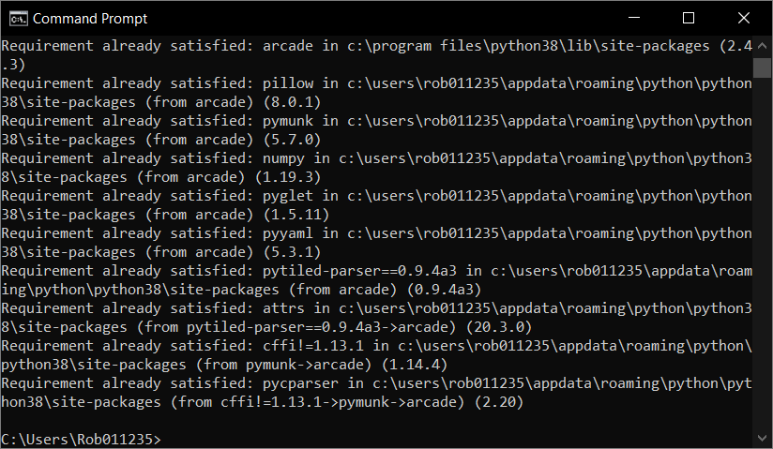
Install Arcade Library
Click Here
Search for command Prompt.
Search for “command prompt”
pip install arcade

Slide 7
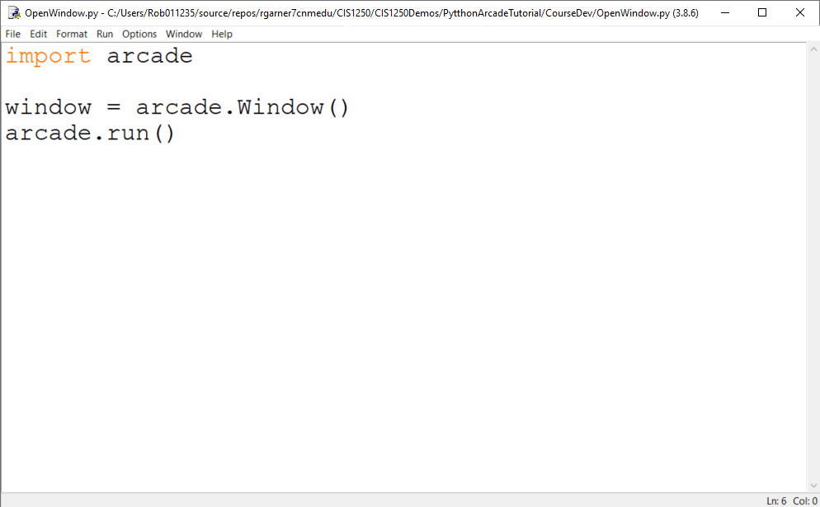
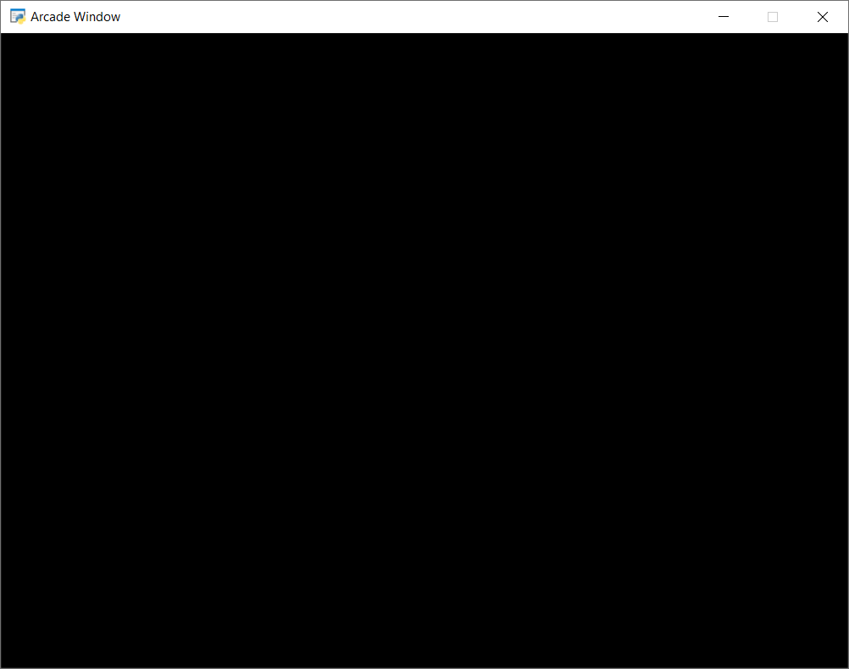
Open a Window
Type code and click F5 to run program.
Blank game window!

Slide 8
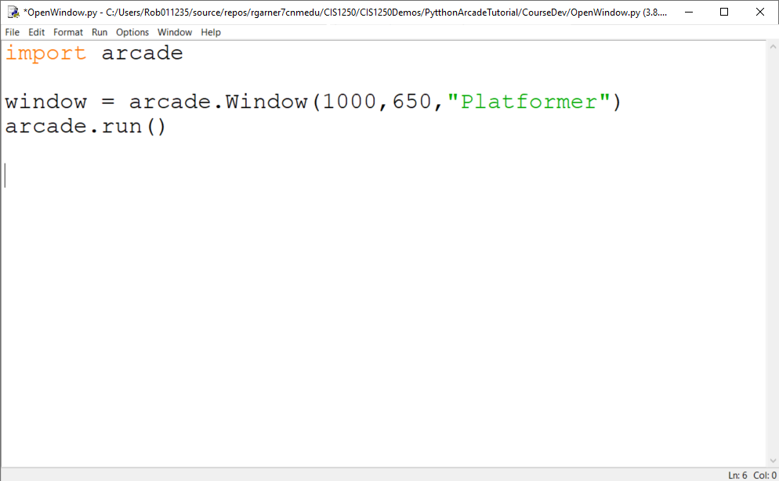
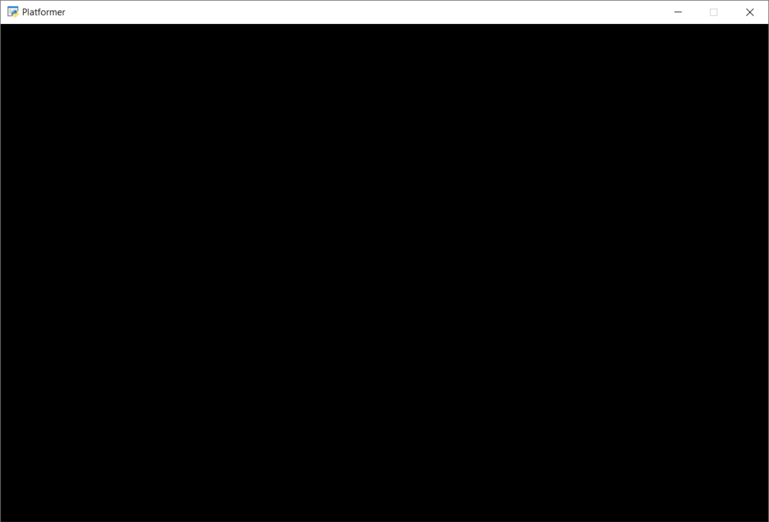
Set width, height and title
1000 pixels wide
Platformer
650 pixels

Slide 9
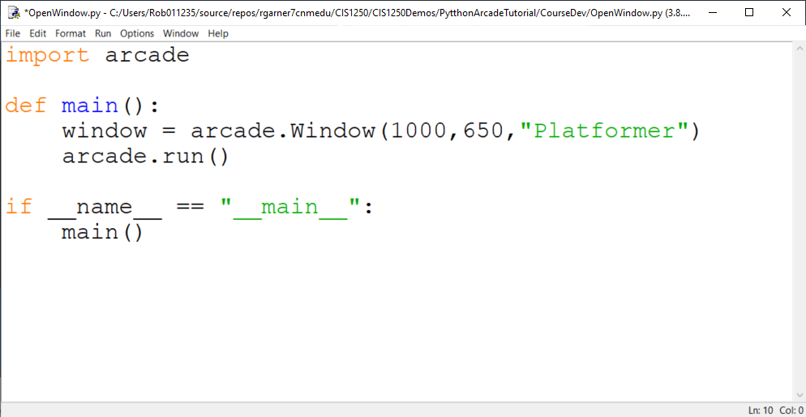
Put code in a main method
Still works!

Slide 10
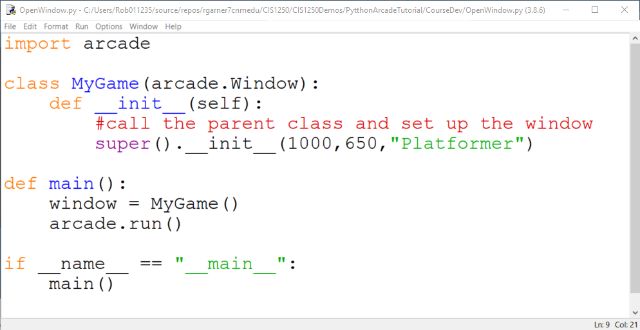
Put Code in a class
Window attributes are now here.
Still works!
“Instantiates” the MyGame class. Kind of like saying “Make MyGame please!”

Slide 11
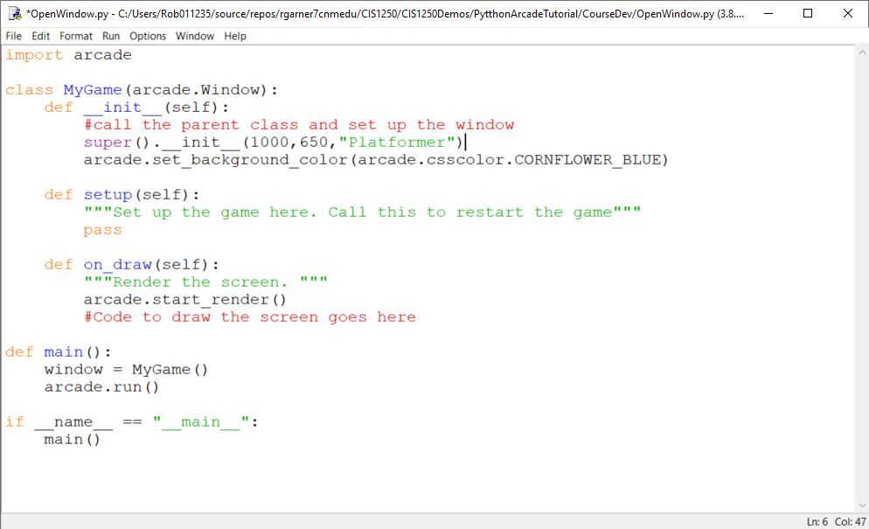
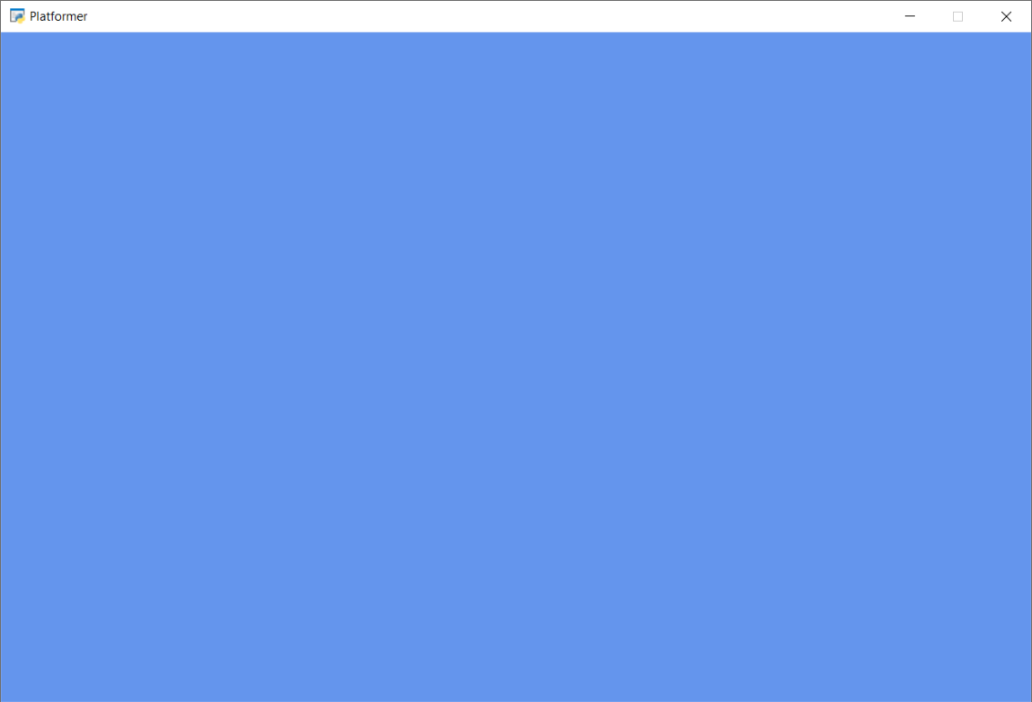
Add setup and on_draw
Blue Background!

Slide 12
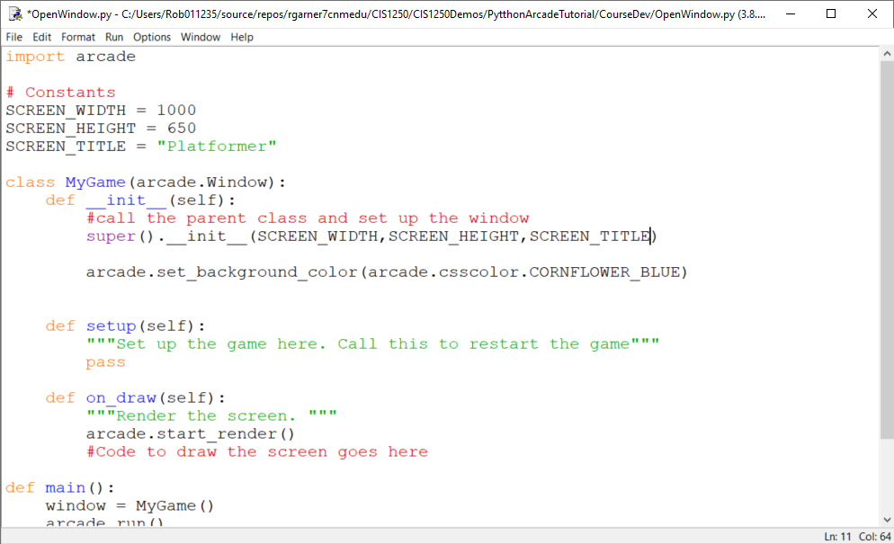
Move attributes to constants
Constants declared at top of program make it easier to change these things later if we want to.

Slide 13
Why both Setup and __init__?
__init__ is used to create and initialize variables
Setup is used to restart the game

Slide 14
Step 2
Add Sprites

Slide 15
Sprite Lists
Sprites are managed in lists. The SpriteList class optimizes drawing, movement, and collision detection.
We are using three logical groups in our game.
A player_list for the player.
A wall_list for walls we can’t move through.
A coin_list for coins we can pick up.

Slide 16
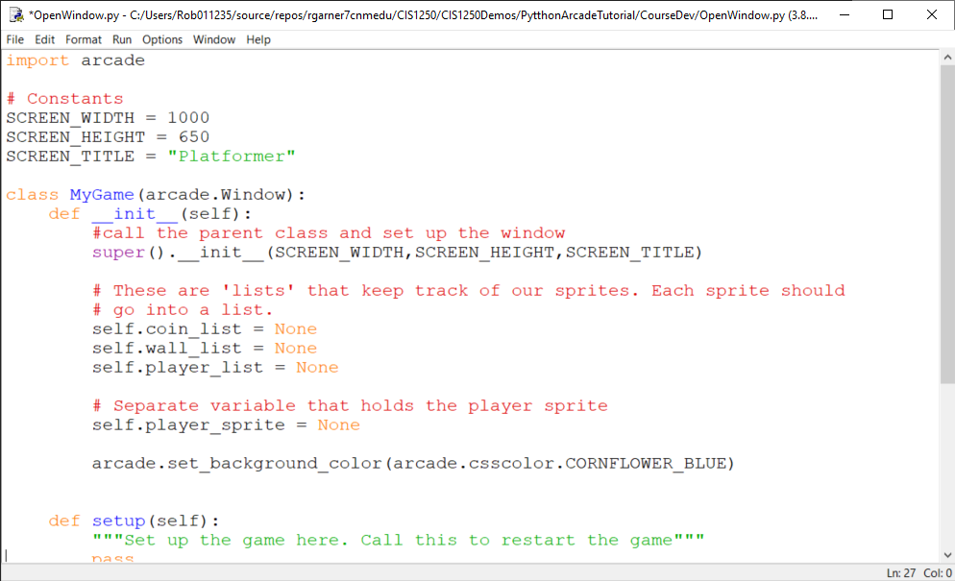
Add sprite lists

Slide 17
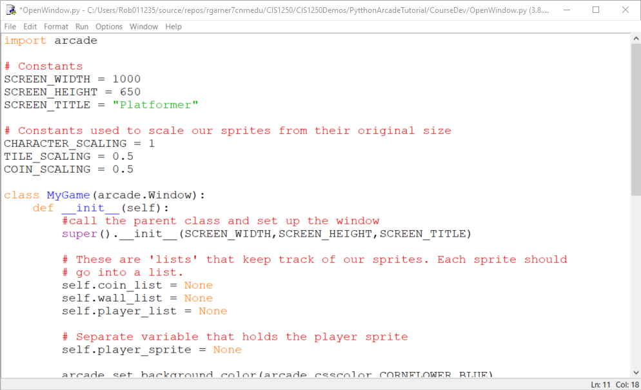
Add some constants for sprites

Slide 18
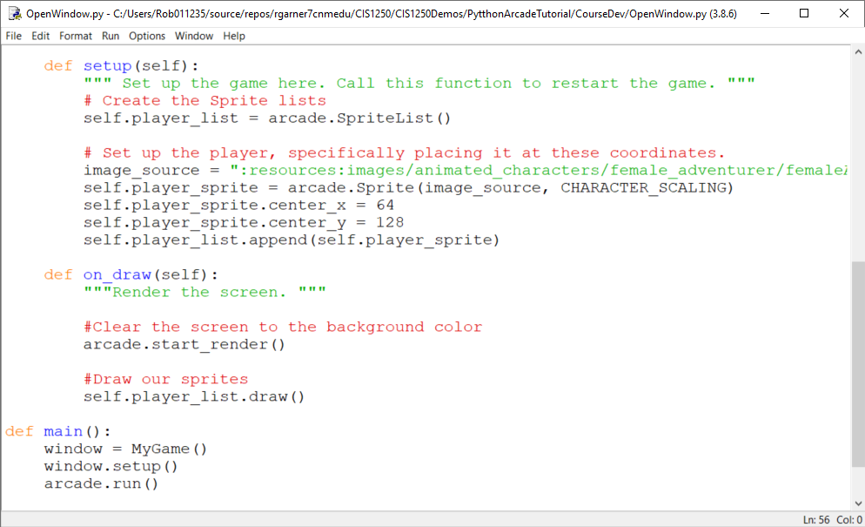
Add player sprite
":resources:images/animated_characters/female_adventurer/femaleAdventurer_idle.png"

Slide 19
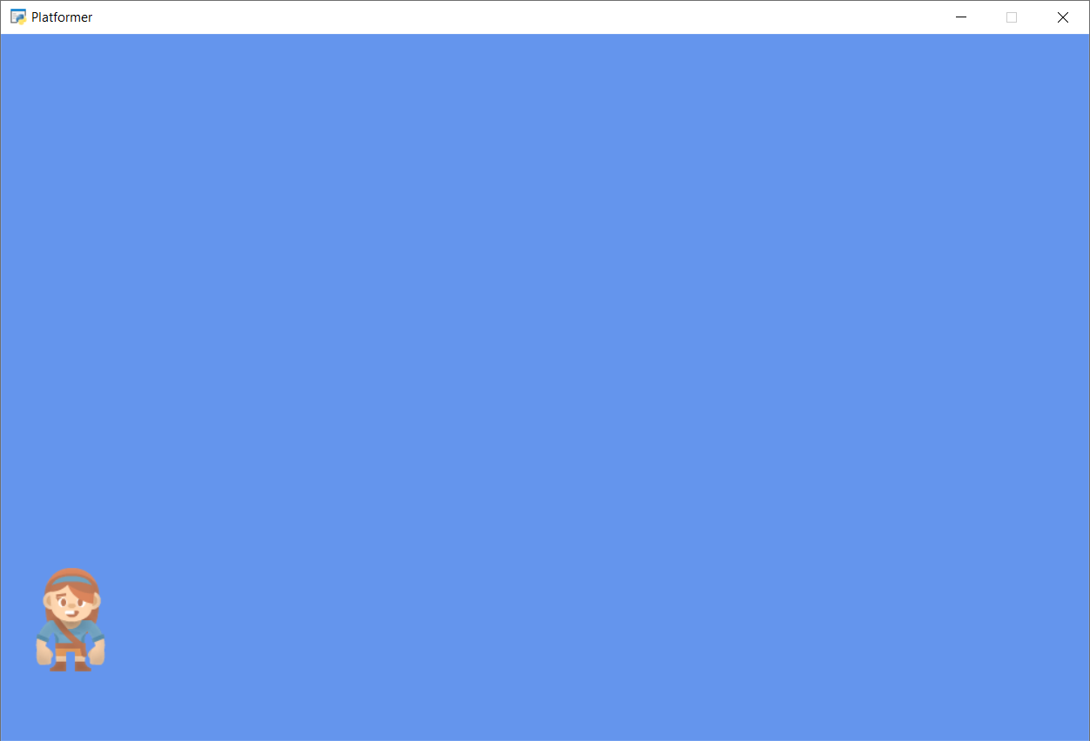
Run with F5
Character Sprite!

Slide 20
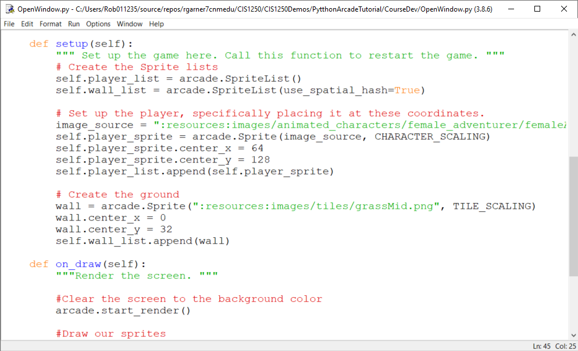
Add the wall list and create ground

Slide 21
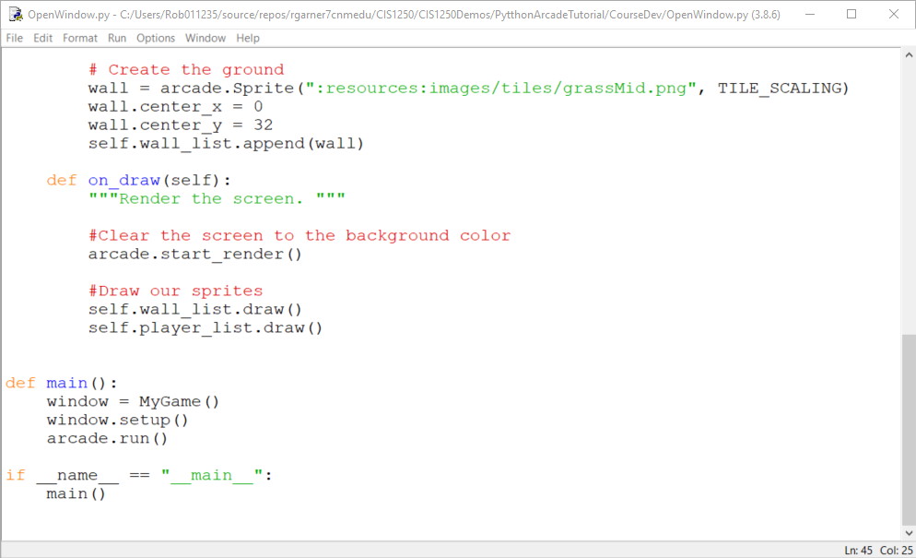
.draw() the wall_list

Slide 22
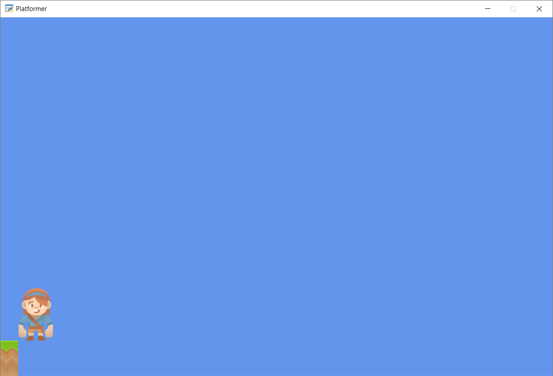
Run with F5
One piece of ground but we need more!

Slide 23
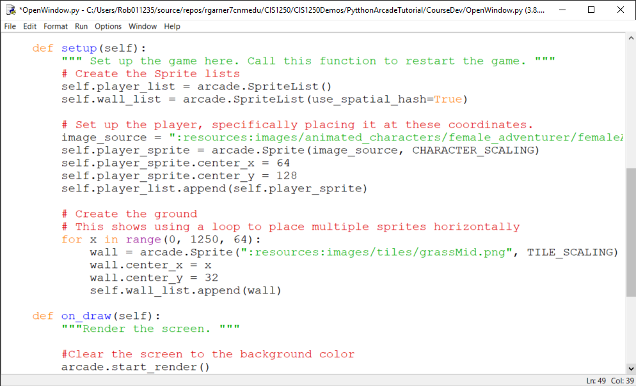
For loop iterates from 0 to 1250 in 64 step increments:
0 then 64 then 128 then 192 etc…
Use x to position each sprite one after the other.
Very important! Indent to identify all the statements that belong to the for loop.

Slide 24
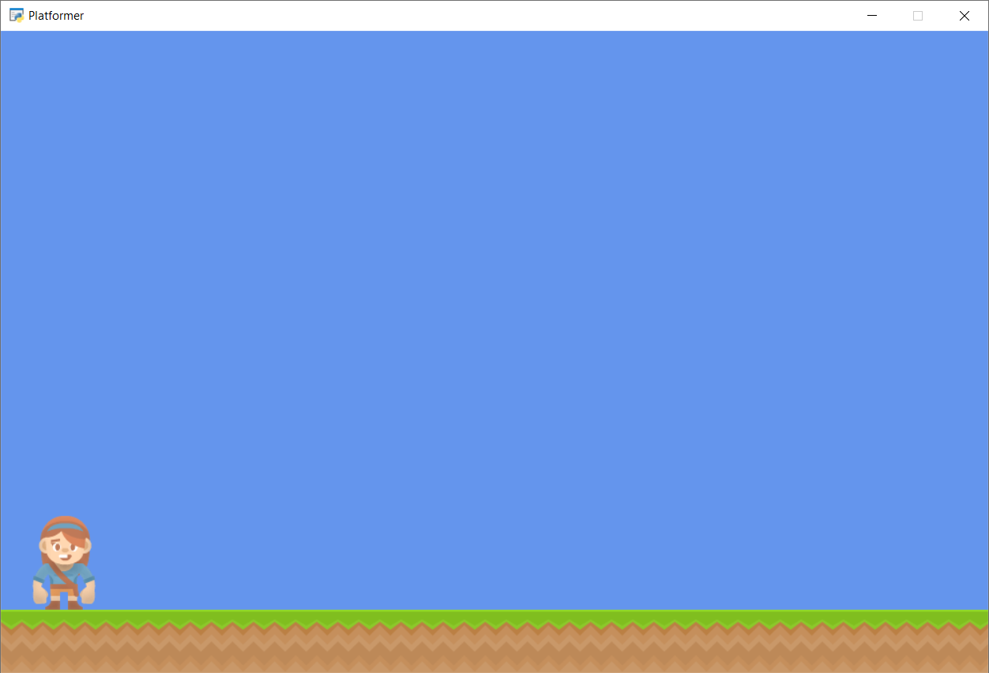
Run with F5
Multiple ground pieces!

Slide 25
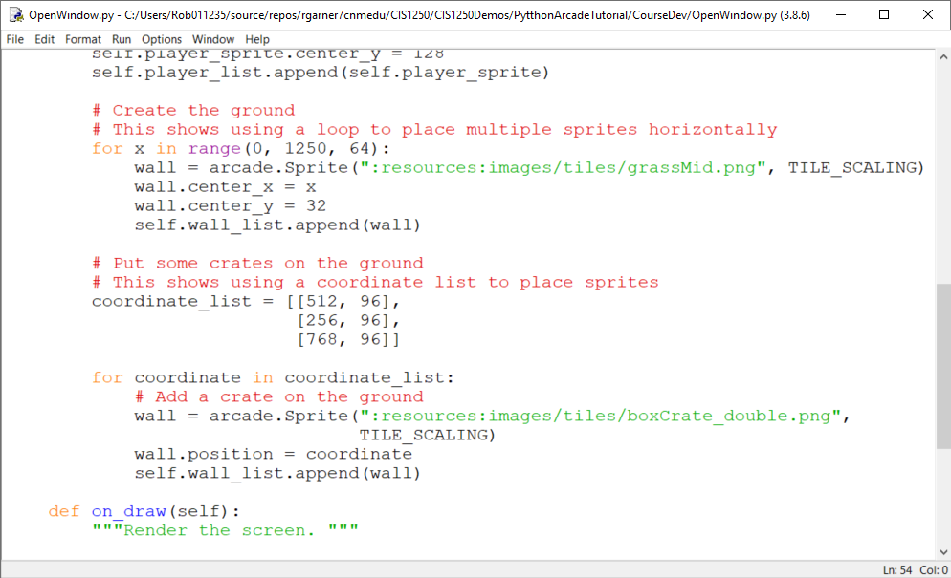
Put some crates on the ground
Create a list of lists with x and y position for three crates.
Loop through all coordinates and put a box there.

Slide 26
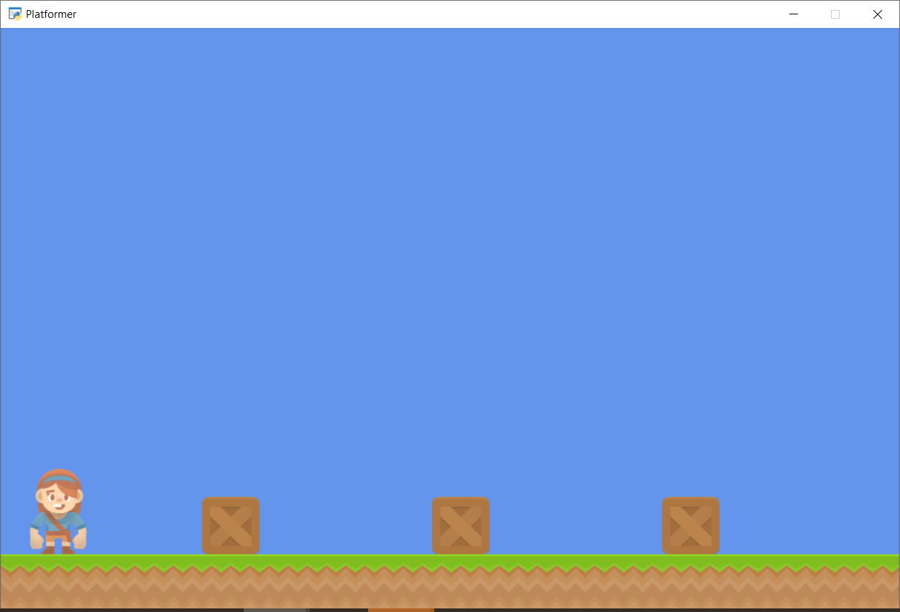
Run with F5
Boxes now show up!
Notes:
"""
Platformer game
"""
import arcade
# Constants
SCREEN_WIDTH = 1000
SCREEN_HEIGHT = 650
SCREEN_TITLE = "Platformer"
# Constants used to scale our sprites from their original size
CHARACTER_SCALING = 1
TILE_SCALING = 0.5
COIN_SCALING = 0.5
class MyGame(arcade.Window):
def __init__(self):
#call the parent class and set up the window
super().__init__(SCREEN_WIDTH,SCREEN_HEIGHT,SCREEN_TITLE)
# These are 'lists' that keep track of our sprites. Each sprite should
# go into a list.
self.coin_list = None
self.wall_list = None
self.player_list = None
# Separate variable that holds the player sprite
self.player_sprite = None
arcade.set_background_color(arcade.csscolor.CORNFLOWER_BLUE)
def setup(self):
""" Set up the game here. Call this function to restart the game. """
# Create the Sprite lists
self.player_list = arcade.SpriteList()
self.wall_list = arcade.SpriteList(use_spatial_hash=True)
# Set up the player, specifically placing it at these coordinates.
image_source = ":resources:images/animated_characters/female_adventurer/femaleAdventurer_idle.png"
self.player_sprite = arcade.Sprite(image_source, CHARACTER_SCALING)
self.player_sprite.center_x = 64
self.player_sprite.center_y = 128
self.player_list.append(self.player_sprite)
# Create the ground
# This shows using a loop to place multiple sprites horizontally
for x in range(0, 1250, 64):
wall = arcade.Sprite(":resources:images/tiles/grassMid.png", TILE_SCALING)
wall.center_x = x
wall.center_y = 32
self.wall_list.append(wall)
# Put some crates on the ground
# This shows using a coordinate list to place sprites
coordinate_list = [[512, 96],
[256, 96],
[768, 96]]
for coordinate in coordinate_list:
# Add a crate on the ground
wall = arcade.Sprite(":resources:images/tiles/boxCrate_double.png",
TILE_SCALING)
wall.position = coordinate
self.wall_list.append(wall)
def on_draw(self):
"""Render the screen. """
#Clear the screen to the background color
arcade.start_render()
#Draw our sprites
self.wall_list.draw()
self.player_list.draw()
def main():
"""Main Method"""
window = MyGame()
window.setup()
arcade.run()
if __name__ == "__main__":
main()

Slide 27
Step 3
Add User Control

Slide 28
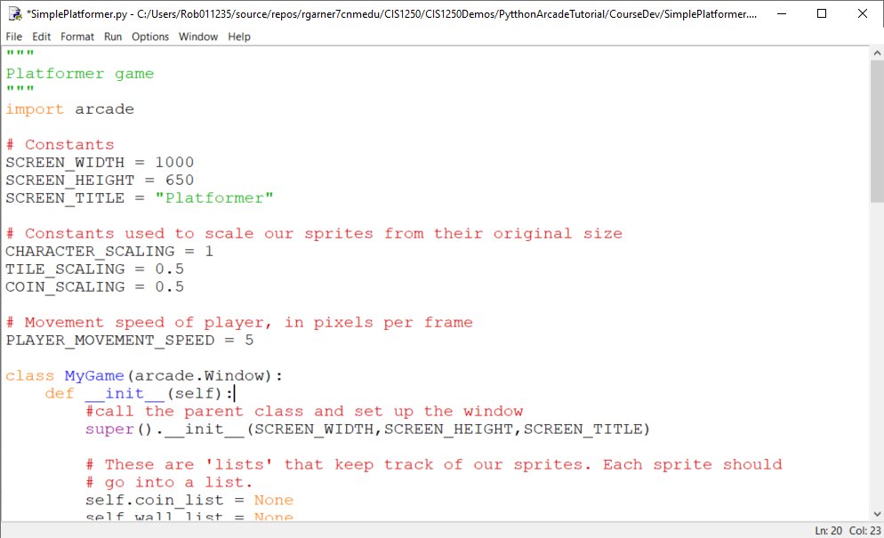
Add constants for player speed
Add constant for player movement speed

Slide 29
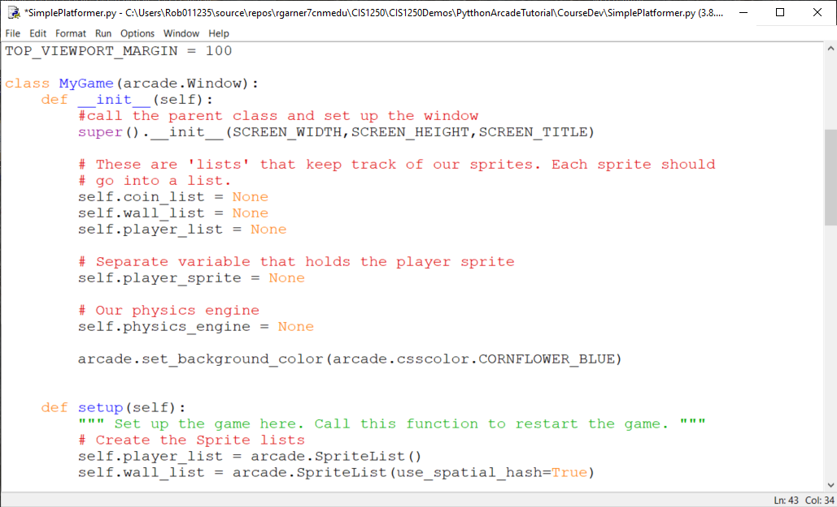
Add a physics engine in __init__
Add a physics engine in __init__

Slide 30
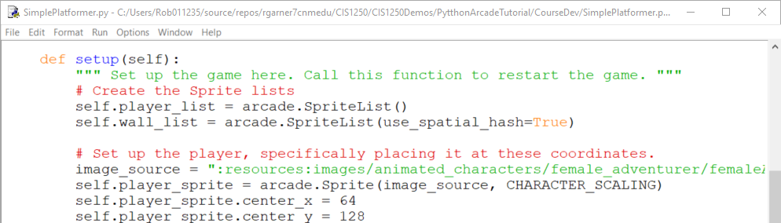
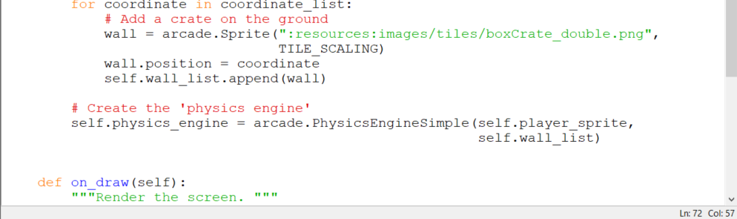
Add a physics engine to setup
Assign a physics engine in setup

Slide 31
Moving Sprites
Each sprite has center_x and center_y attributes.
Changing these will change the location of the sprite.
Each sprite has change_x and change_y variables.
These can be used to hold the velocity that the sprite is moving with.
We will adjust these based on what key the user hits.
If the user hits the right arrow key we want a positive value for change_x.
If the value is 5, it will move 5 pixels per frame.

Slide 32
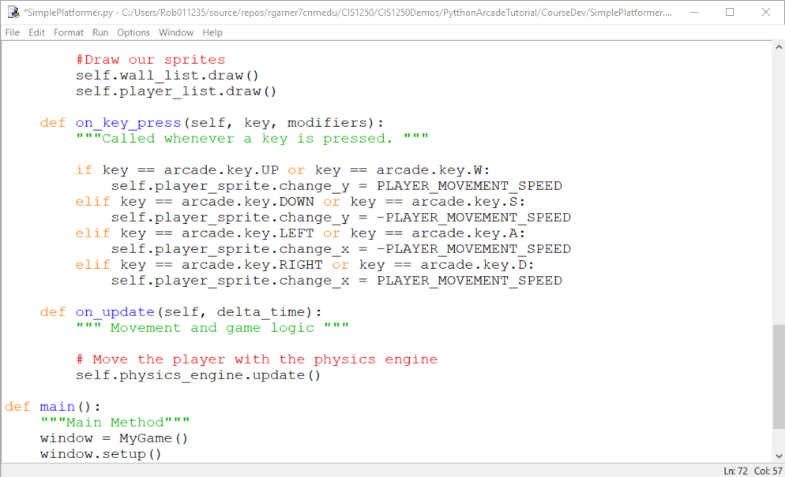
Add on_key_press and on_update
On_key_press responds to key presses.
On_update updates all moving objects each frame.

Slide 33
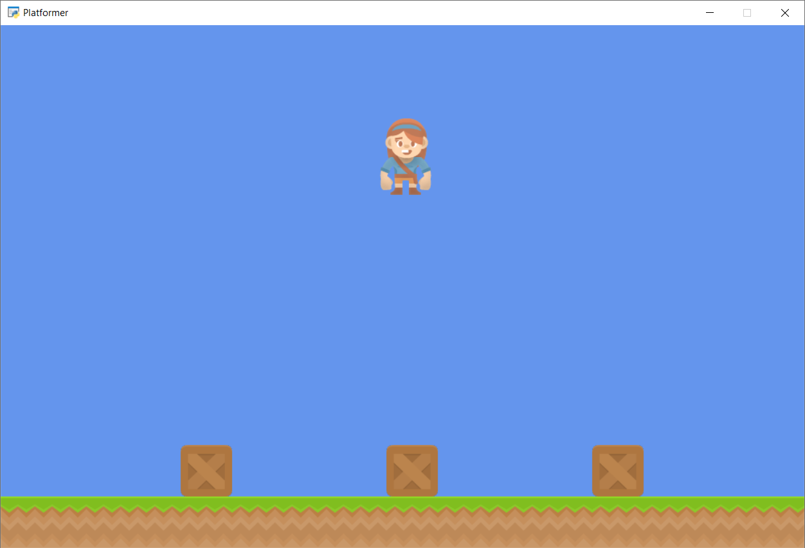
Run with F5
What went wrong?

Slide 34
Change_x and Change_y
Change_x and change_y will cause the player to keep moving every frame until we tell it to stop!
So the player moves continuously.
Also…
There is no gravity! So the player is flying!

Slide 35
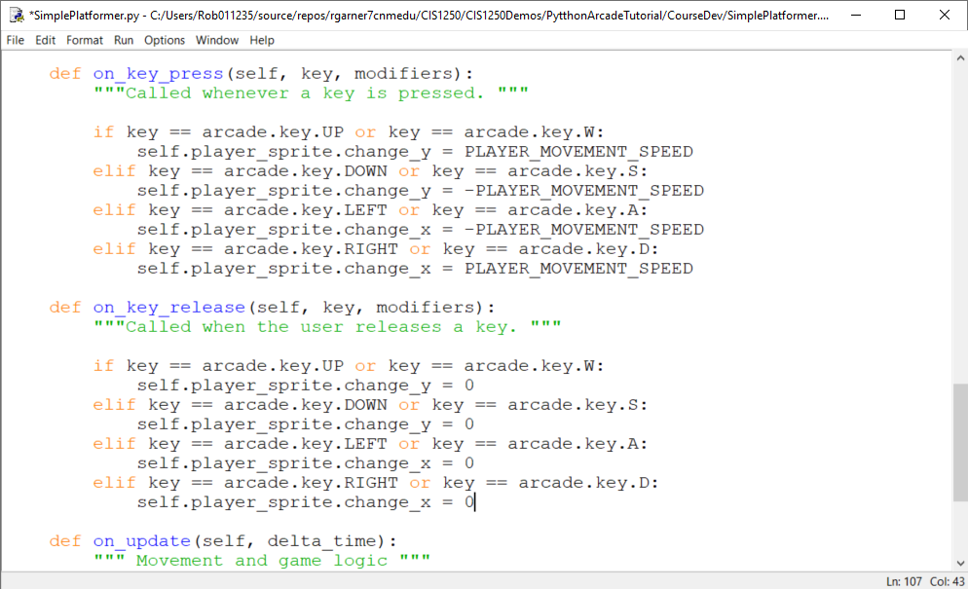
Add on_key_release
On_key_release responds when you let go of a key.

Slide 36
Run with F5
Character still flies but at least it stops when you let go of the key.

Slide 37
Why both a on_key_press as well as an on_key_release?
We often need to handle both on_key_press as well as on_key_release
It depends on how you want the game to behave.
It’s your game you can make it behave any way you want!
Next time you play a game ask yourself how the programmer may have set up the key presses.

Slide 38
Step 4
Add Gravity

Slide 39
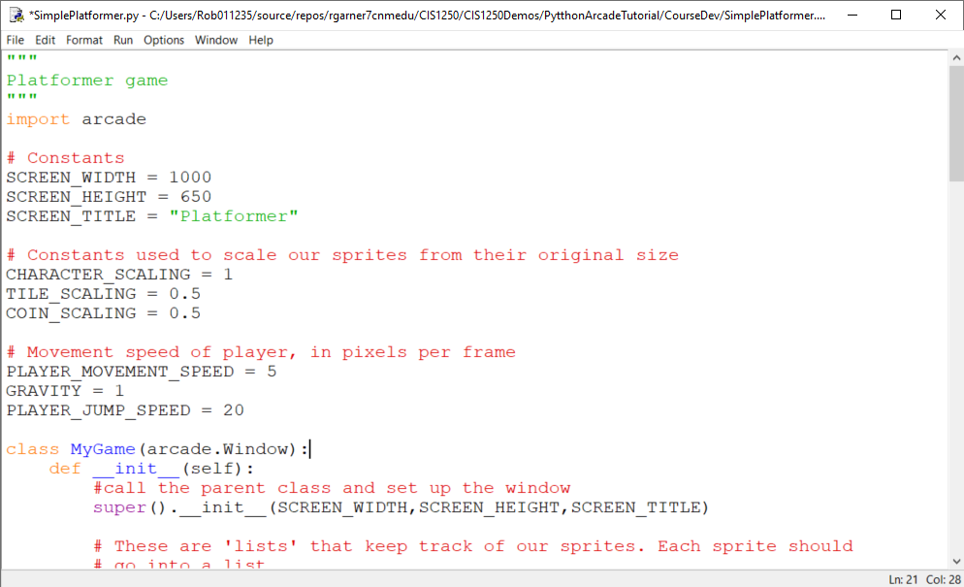
Add constants for gravity and jump speed.
Add constants for gravity and jump speed.

Slide 40
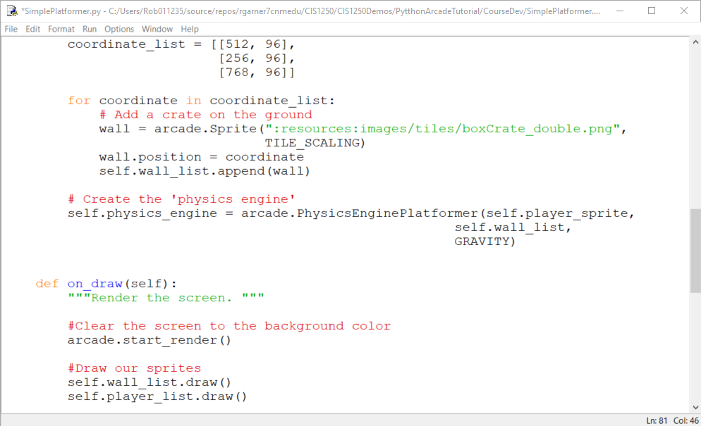
Change physics engine
Change to PhysicsEnginePlatformer
Add GRAVITY to physics engine.

Slide 41
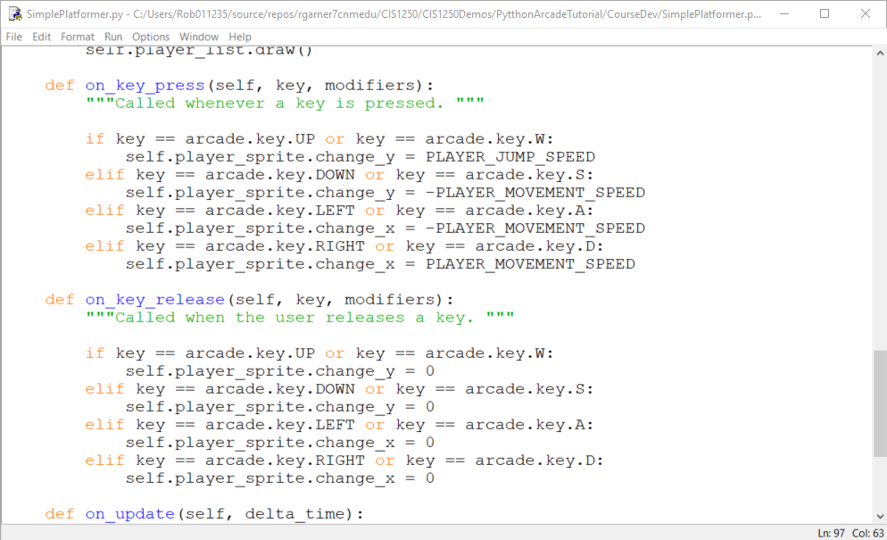
Change W to use jump speed
Change to PLAYER_JUMP_SPEED

Slide 42
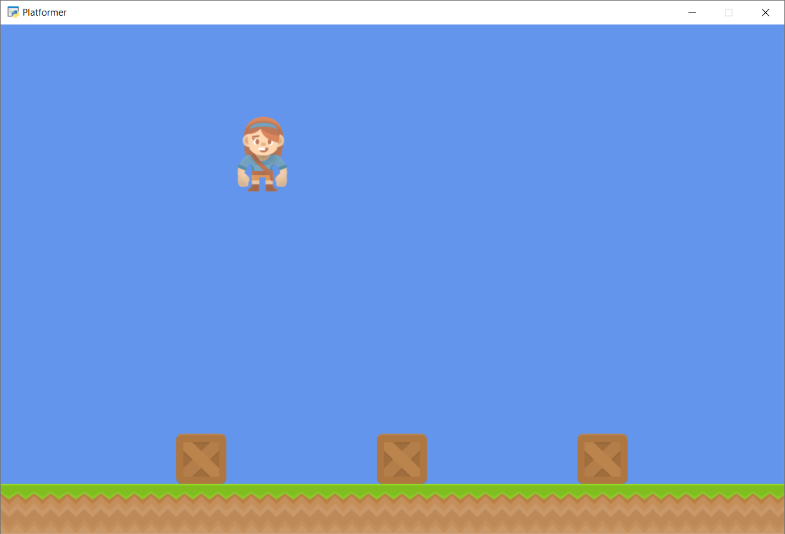
Run with F5
What game is that like?
Character now falls but what happens if we hit W multiple times?

Slide 43
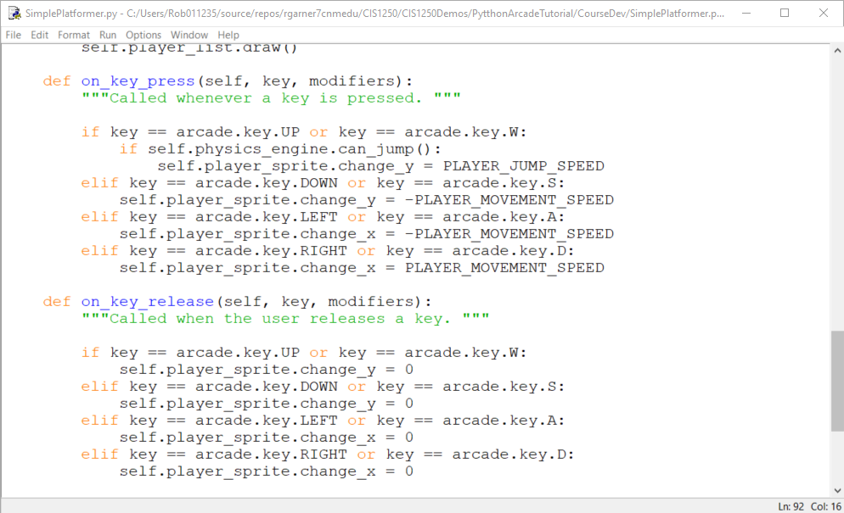
Add a check of can_jump()
Add an if statement to check if can_jump()

Slide 44
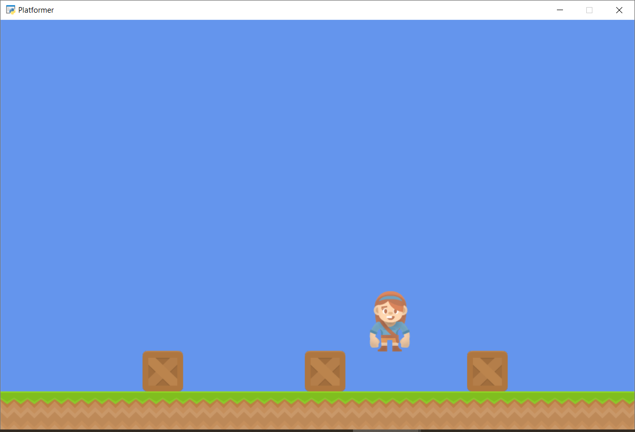
physics_engine.can_jump()
What does physics_engine.can_jump() mean?
What happens now if we hit W multiple times?

Slide 45
can_jump() is true if player is in contact with ground!
Checks to see if player is in contact with the ground!

Slide 46
Step 5
Add Scrolling

Slide 47
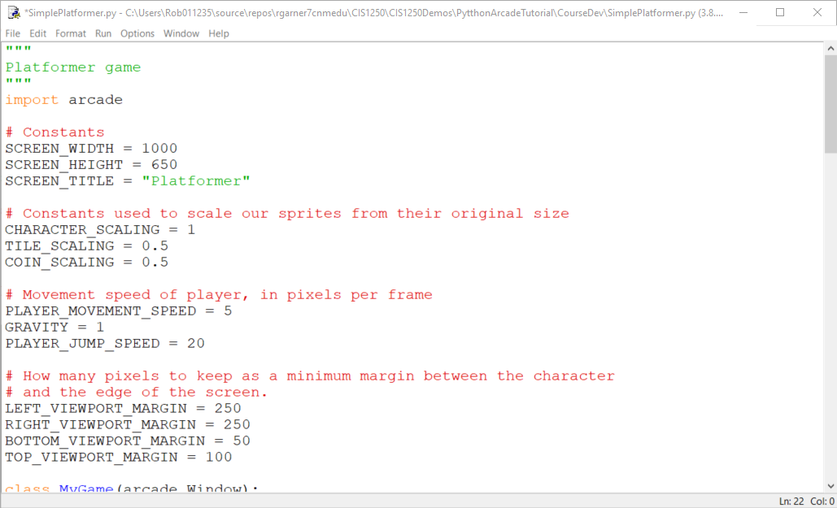
Add constants for viewport

Slide 48
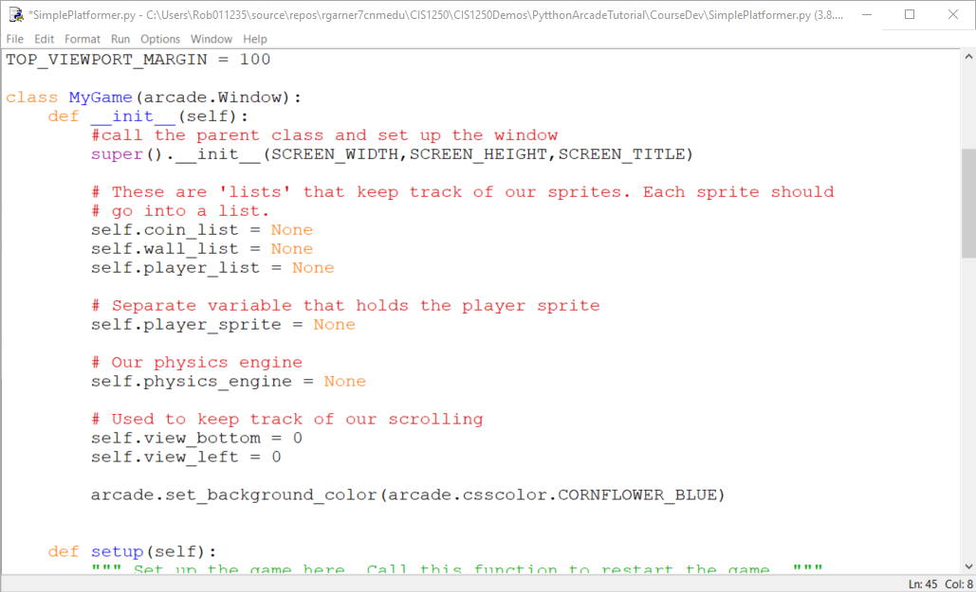
Add variables to keep track of scrolling

Slide 49
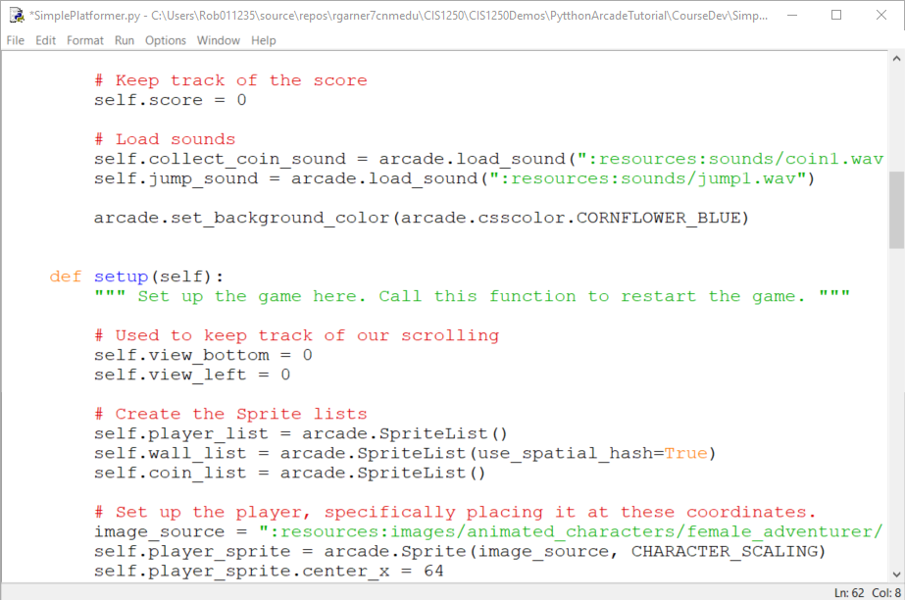
Add variables in setup as well to handle restarts

Slide 50
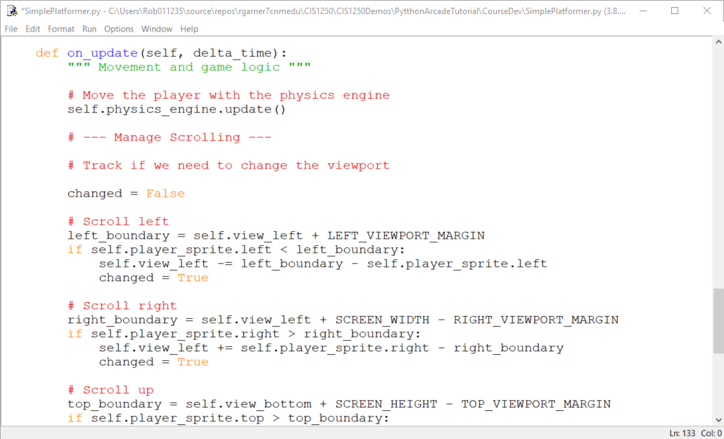
Add code to manage scrolling

Slide 51
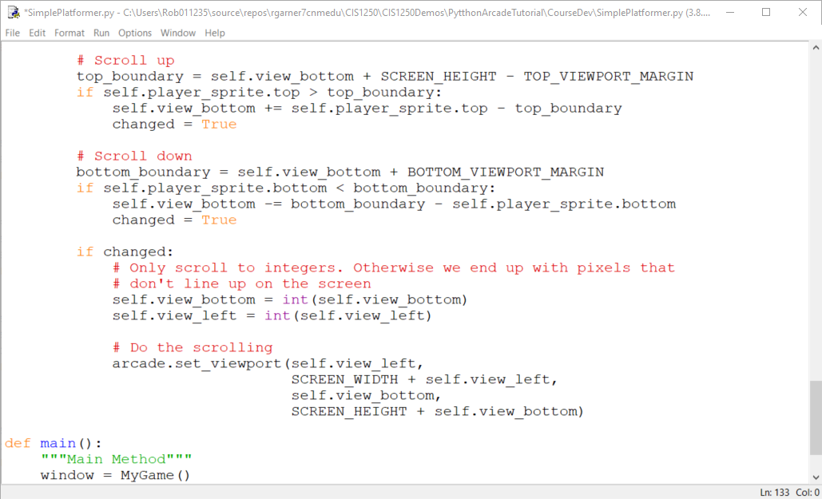
Remaining scrolling code

Slide 52
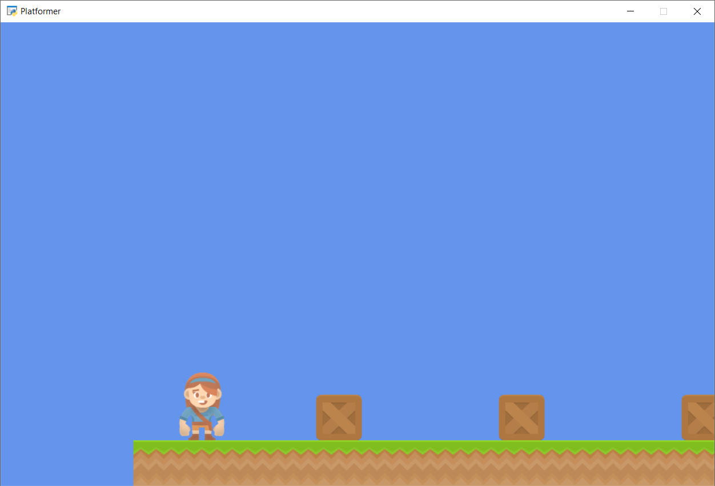
Run with F5
Navigate to the edge of the scene.

Slide 53
Step 6
Add Coins And Sound

Slide 54
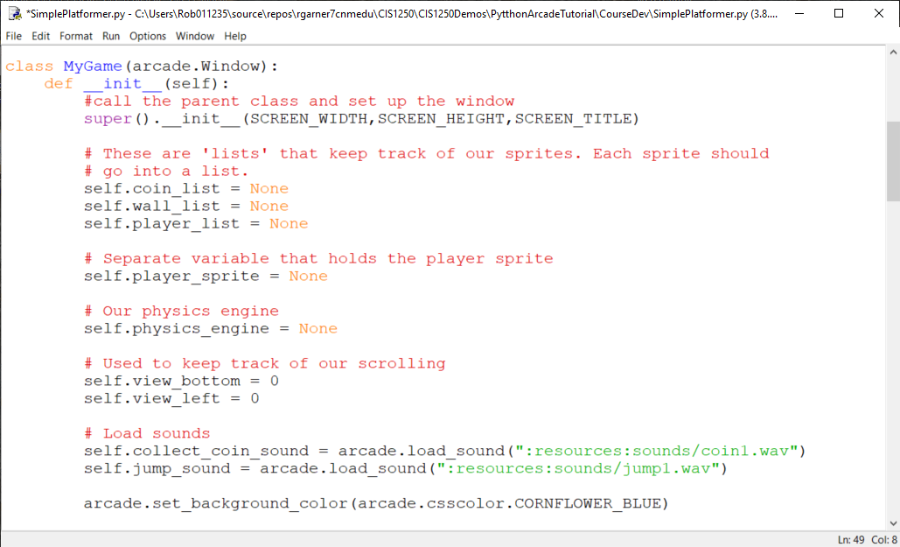
Add sounds to __init__ method
Use arcade.load_sound(…)

Slide 55
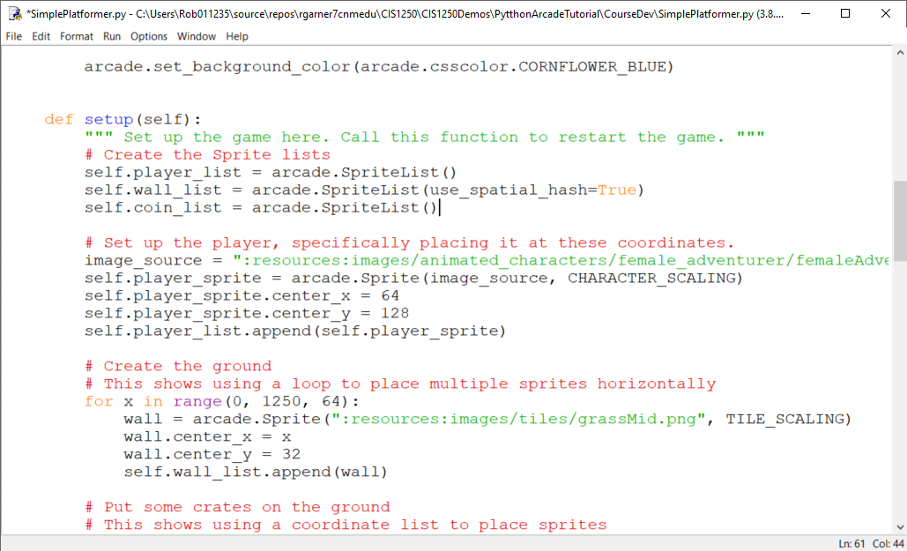
Add a SpriteList for coins in Setup
Add a SpriteList for coins.

Slide 56
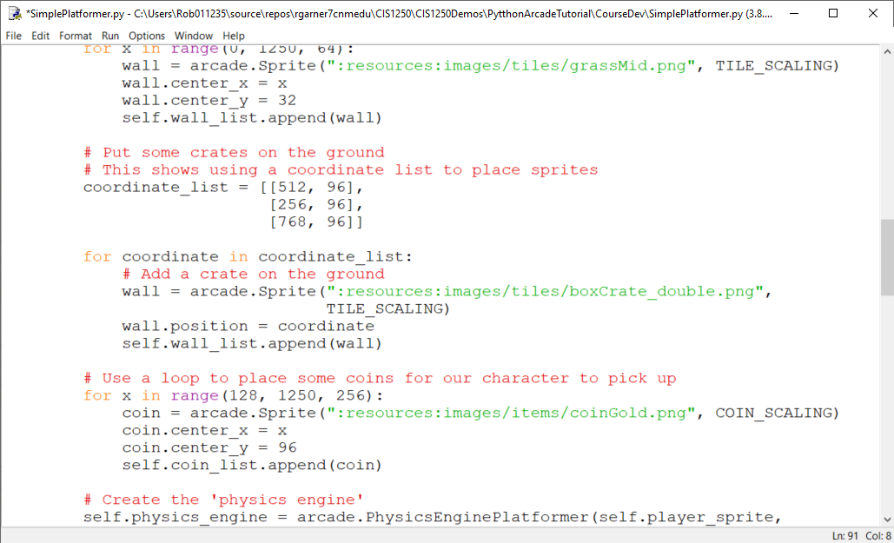
Place coins
Use a for loop to place coins.

Slide 57
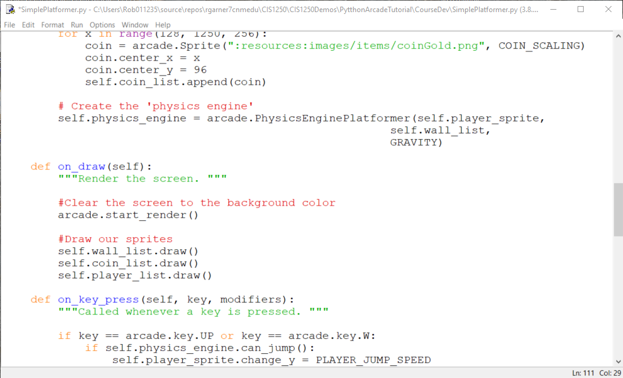
Draw coin list
Add a draw command.

Slide 58
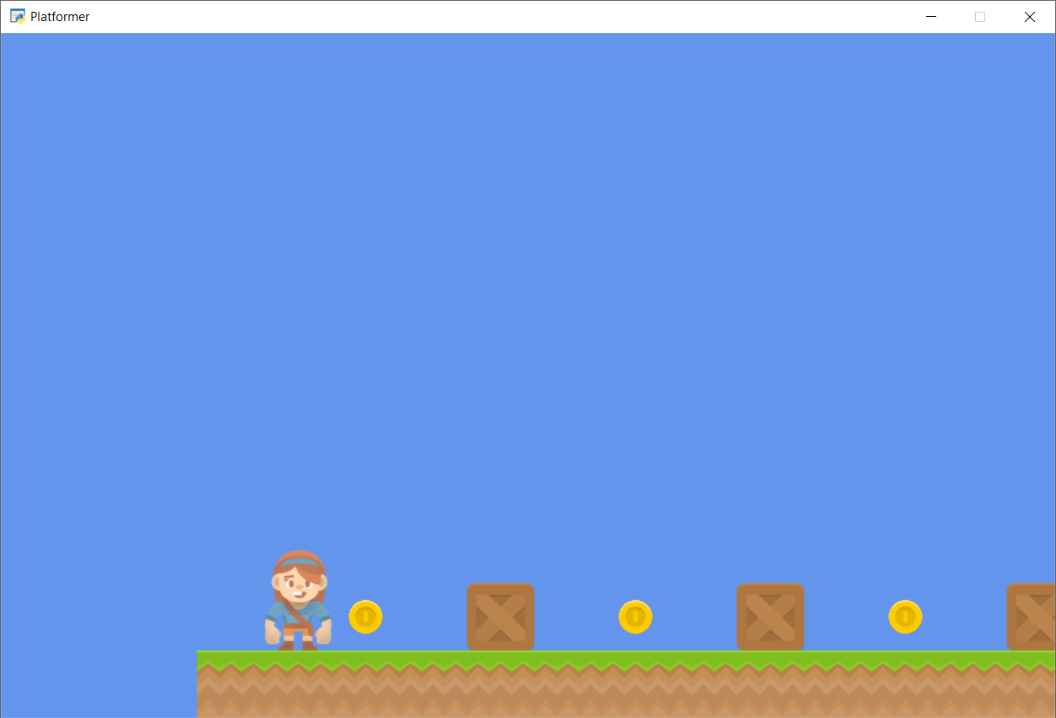
Run with F5
Coins!

Slide 59

Add sound when player jumps
Add a call to play sound.

Slide 60


Run with F5
Jumping should make sound!

Slide 61

Check to see if we hit coins in update method.
Check to see if we hit coin by using check_for_collision_with_list method.
Play sound if hit coin.

Slide 62

Run with F5
Going over coins makes sound.

Slide 63
Step 7
Display The Score

Slide 64

Add variable to keep score in __init__
Add self.score to keep track of score.

Slide 65

Add variable to keep score in setup as well
Add self.score to keep track of score.

Slide 66

Draw the score on the screen
Use draw_text

Slide 67

Increment score when player collides with coin.
Increment score

Slide 68

Score Displayed

Slide 69
Step 8
Use a Map Editor

Slide 70
Create a Map File
For this part, we’ll restart with a new program.
Instead of placing our tiles by code, we’ll use a map editor.
Download and install the Tiled Map Editor.
https://www.mapeditor.org/

Slide 71

Click on Download link
Click Here

Slide 72

Click on Download link
Click Here

Slide 73

Donation is optional
Click here to try for free.

Slide 74

Select appropriate version for your machine.

Slide 75

Click File -> New Map
Click here New Map

Slide 76

Enter configuration and click Save As
Click here

Slide 77

Save as map.tmx

Slide 78

Change to Platforms
Click on New Tileset

Slide 79
Step 9
Multiple Levels and Other Layers

Slide 81
Step 10
Add Ladders, Properties, and a Moving Platform

Slide 83
Step 11
Add Character Animations, and Better Keyboard Control

Slide 85
Summary
Step 1 - Install and Open a Window
Step 2 - Add Sprites
Step 3 - Add User Control
Step 4 - Add Gravity
Step 5 - Add Scrolling
Step 6 - Add Coins And Sound
Step 7 - Display The Score
Step 8 - Use a Map Editor
Step 9 - Multiple Levels and Other Layers
Step 10 - Add Ladders, Properties, and a Moving Platform
Step 11 - Add Character Animations, and Better Keyboard Control

